Slide 1

Heart Disease Prediction Using Machine Learning
A data-driven approach to early cardiac risk detection — analyzing patient health parameters with multiple ML classification algorithms to support clinical decision-making.
B.TECH PROJECT · 2023–2027
THUNGETI RAJASEKHAR

Slide 2


Project Overview
Why Predict Heart Disease with ML?
Cardiovascular disease remains the leading cause of death worldwide. Early detection through machine learning can analyze patient health parameters — age, cholesterol, blood pressure, heart rate, and more — to estimate the likelihood of heart disease before symptoms appear.
Predict
Compare
Detect Early
Classify patients as at-risk or healthy
Evaluate multiple ML algorithms
Support proactive clinical decisions

Slide 3





Technologies Used
The project is built entirely in Python, leveraging a modern data science stack for data manipulation, visualization, and machine learning.
Python
Pandas & NumPy
Matplotlib
Core programming language
Data wrangling and numerical computation
Visualization and result plotting
Scikit-learn
Jupyter Notebook
ML model training and evaluation
Interactive development environment

Slide 4
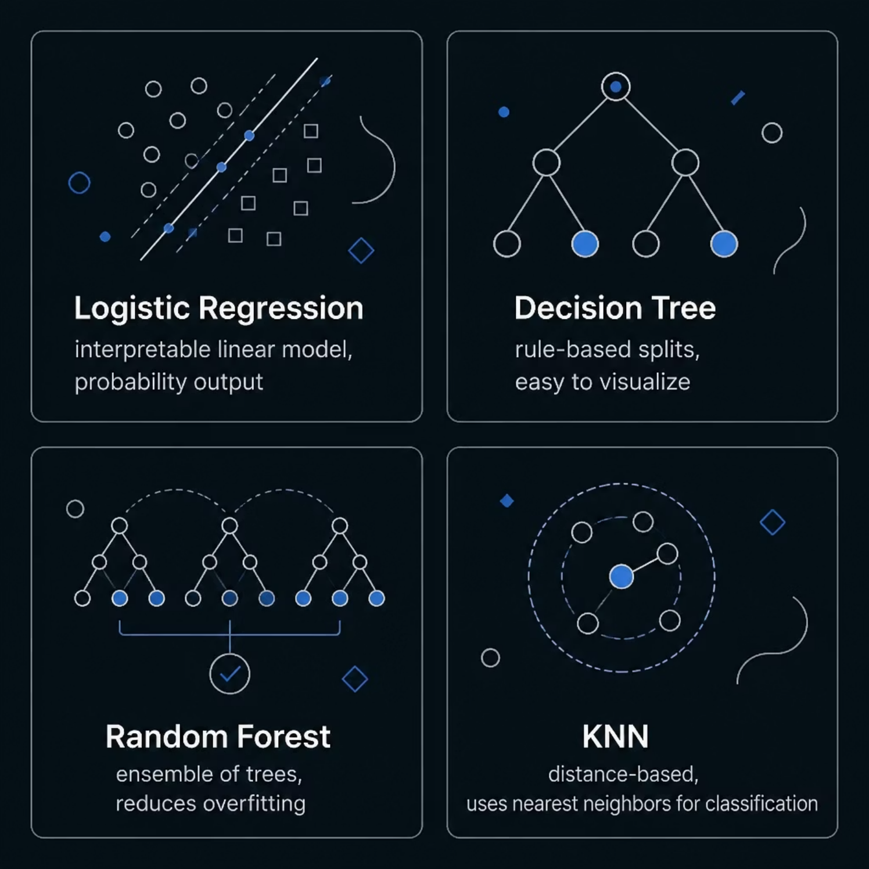

Machine Learning Models
Four Classification Algorithms Compared
Each algorithm brings a distinct approach to classification. By comparing them on the same dataset, the project identifies which model best balances accuracy, interpretability, and generalization for cardiac risk prediction.
Random Forest typically outperforms single-tree models by aggregating predictions across multiple decision trees, reducing variance and overfitting.

Slide 5




Dataset
Patient Health Parameters
The model is trained on a structured medical dataset containing real patient records. Each record includes clinical measurements that serve as input features for prediction.
Demographics
Cardiac Metrics
Age, sex, and patient profile information
Resting blood pressure, maximum heart rate, ECG results
Blood Chemistry
Stress Indicators
Serum cholesterol, fasting blood sugar levels
Exercise-induced angina, ST depression, slope

Slide 6
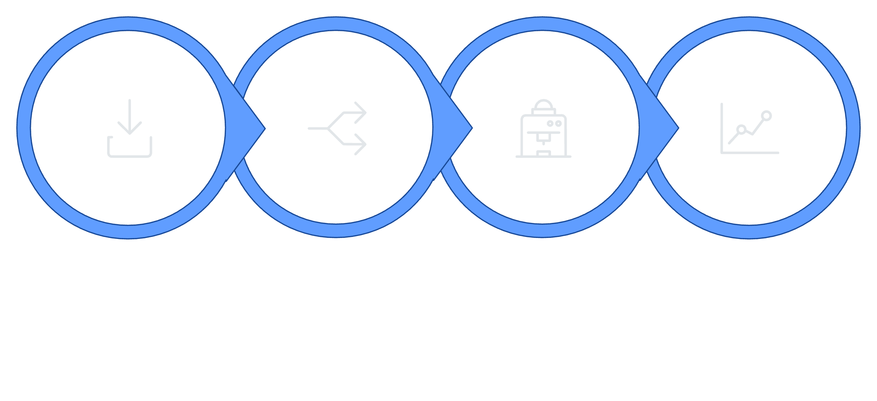
Workflow
From Data to Prediction
Load & Preprocess
Evaluate & Predict
Split Data
Train Models
The pipeline follows a standard supervised learning workflow: raw patient data is cleaned and encoded, split into training and testing sets, fed into each classifier, and finally evaluated for accuracy before generating predictions.

Slide 7
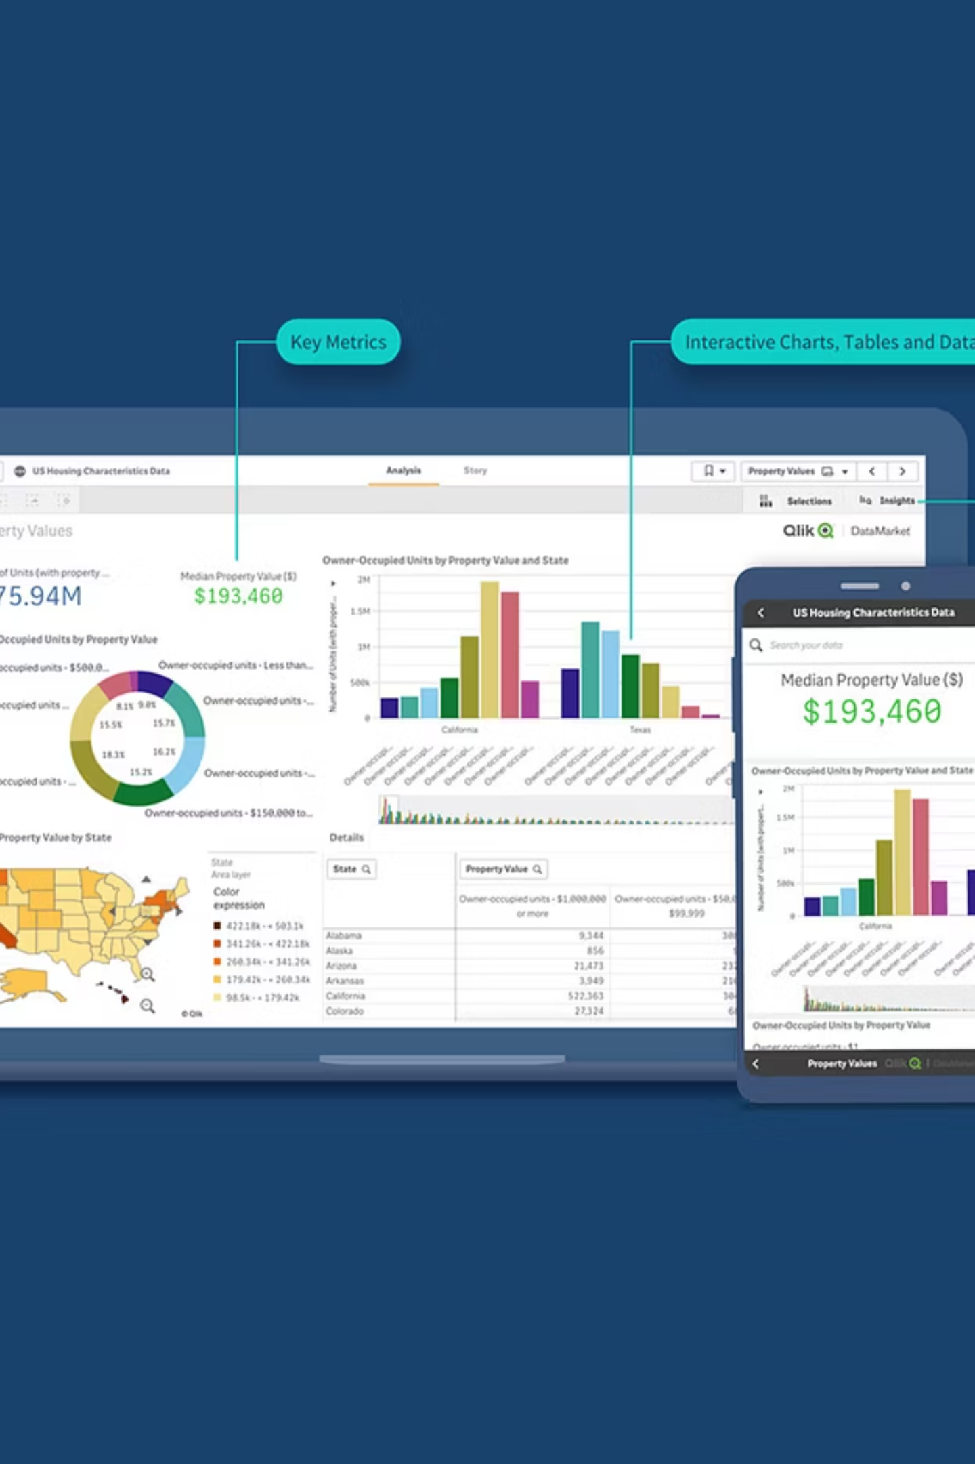

Running the Project & Expected Output
01
02
Install Dependencies
Run the Script
pip install -r requirements.txt — installs Pandas, NumPy, Scikit-learn, and Matplotlib.
python heart_disease_prediction.py — loads the dataset, trains all four models, and evaluates performance.
03
View Results
The system outputs a heart disease prediction (positive/negative) along with accuracy scores for each algorithm.
Project by Thungeti Rajasekhar · B.Tech (2023–2027) · Annamacharya Institute of Science and Technology

